Slide 1
AUTOMATED PLANT WATERING
Team members: Project Guide:
Isukapalli Pratyusha (13A91A0518) Mrs. A. Vanathi, M.E.,(Ph.D.)
Ch. Aruna Devi (13A91A0508) Associate Professor.
N. Sankesh Reddy (13A91A0540)
Akunuri Sruthi (13A91A0501)

Slide 2
Abstract:
Watering is the most important and most labor intensive task in daily green house operation. To ease this process and reduce the burden of the gardener, this process is automated. There are two important aspects to be known to water a plant. They are, when and how much water to be given to the plant. For this, we use soil moisture sensor to detect the moisture in the atmosphere. And to carry out the operations and conditions upon which the system acts will be controlled by a hardware component ARDUINO. The amount of water to be given to the plant is controlled by the mobile through a message using GSM module. So this automation lessens the effort of human to water a plant. It helps the plant grow healthy by avoiding non-watering and over watering.

Slide 3
Introduction:
Now a days every process is getting automated. This automation of the process is possible with the help of embedded systems. The process of connecting various hardware and devices to make them act as a single system is called embedded system. The main advantage of the usage of this embedded system is the labor of human in performing tasks get reduced. There are various applications of embedded system in various fields like security, home automation, agriculture, etc.

Slide 4
Existing system:
An automatic drip irrigation system with an automatic timer which controls the frequency and run time of the water for the plants. This battery operated timer, once set, takes care of watering the plant. Consider the fact that more and more towns and villages are moving towards urbanization . Because of busy schedules of metro life, people don’t find time to water the plants regularly.

Slide 5
Disadvantages:
Over watering
Fixed time period
More frequency
No change during suitable climate

Slide 6
Proposed system:
To overcome over watering we this system has time management system which can be achieved by setting the time manually through the mobile. There can be different set of time periods to water the plants, through which we can overcome the fixed frequency problem in the former system. With the help of sensor we can change the time period to water the plant for its healthy growth.

Slide 7
Advantages:
Flexibility.
No non-watering.
No over watering.
Manageable time period.
Manageable frequency

Slide 8
Architecture:
DHT11
sensor
GSM900
Mobile app
Arduino
Relay

Slide 9
System Requirements:
This embedded system needs both hardware and software for its successful execution. The hardware components of this system acts accordingly as specified by the software instructions.
Therefore, there are both hardware and software requirements for this system.

Slide 10
Hardware Requirements:
Arduino : UNO
GSM Module : 900
Soil moisture sensor
Relay Module
Patch chords

Slide 11
Software Requirements:
Arduino Software
Programming Language : Embedded C++
Xml
Java

Slide 12
Modules:
To make the project understandable and easy it is divided into following modules.
Interfacing Arduino and DHT11 sensor
Interfacing Arduino and GSM module
Integrating GSM message and Mobile Application
Interfacing Arduino and Motor(Relay).

Slide 13
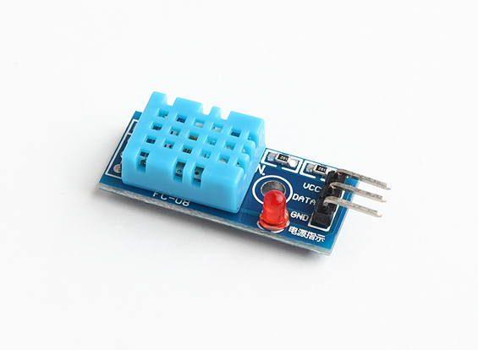
Interfacing Arduino and DHT11 Sensor:
There are three pins for DHT11 sensor. They are:
VCC
DATA
GND
These pins are connected to Arduino, i.e.,
Arduino 5V→DHT11 VCC
Arduino 3 →DHT11 DATA
Arduino GND→DHT11 GND

Slide 14
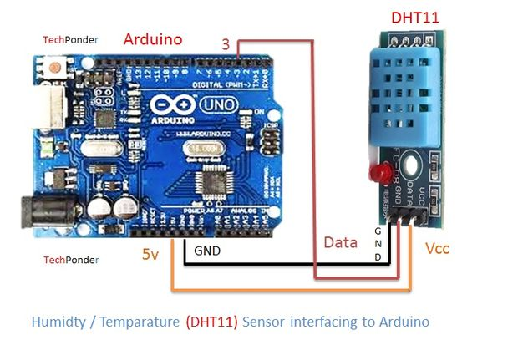

Slide 15
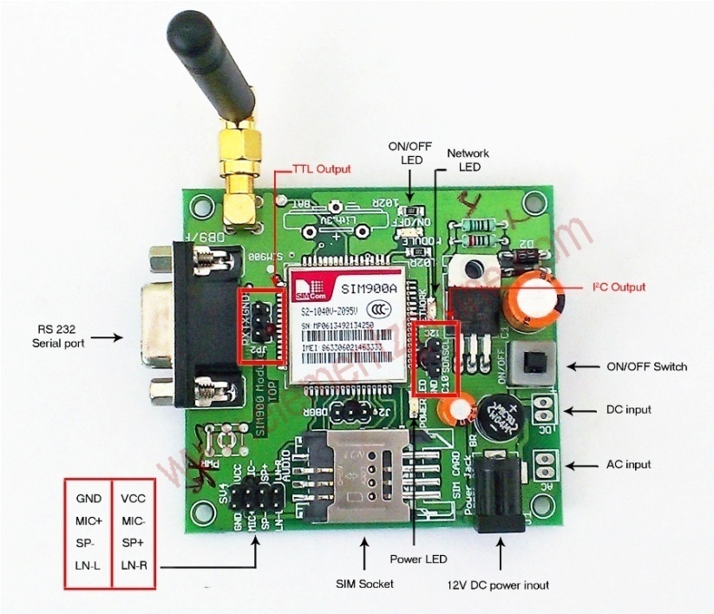
Interfacing Arduino and GSM900:
There are three pins for GSM900 which are used for this system. They are:
GND
RX
TX
These pins are connected to Arduino as follows:
Arduino GND→GSM GND
Arduino RX →GSM TX
Arduino TX →GSM RX

Slide 16
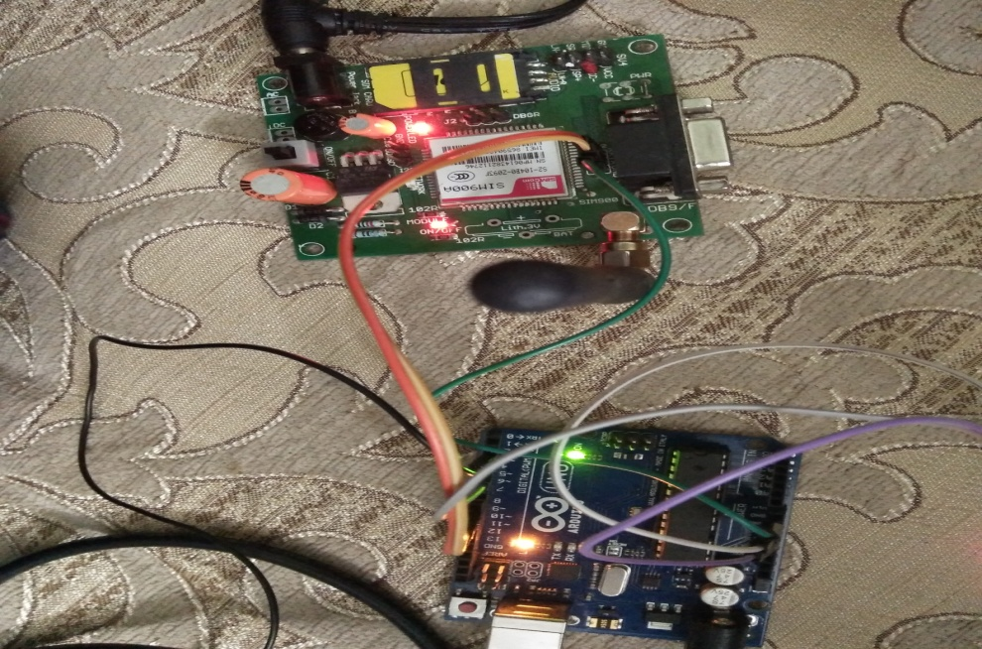

Slide 17
Integrating GSM and mobile application
The data which is received by the Arduino from DHT11 sensor must be give to the user through GSM module.
For this the messages should be clear for the user to, which can be achieved by a mobile application.
This mobile application imports the messages which are received by the arduino and displays the message on message layout.
The user in turn responds in the form of time in separate layout in the same mobile application.

Slide 18
Integrating arduino and Motor:
The motor has two pins. They are:
GND
VCC
These pins are connected to the Arduino in the following way:
Arduino GND→ Motor GND
Arduino 5V → Motor VCC

Slide 19
UML Diagrams:
Use case diagram
Class diagram
Sequence diagram
Collaboration diagram

Slide 20
Use case Diagram:

Slide 21
Class Diagram:

Slide 22
Sequence Diagram:

Slide 23
Collaboration Diagram:

Slide 24
Screen shots:
Screen shot of sending message
Screen shot of receiving message
Screen shot of splash screen
Screen shot of message display screen with error
Screen shot of toast message
Screen shot of sending message through mobile application

Slide 25
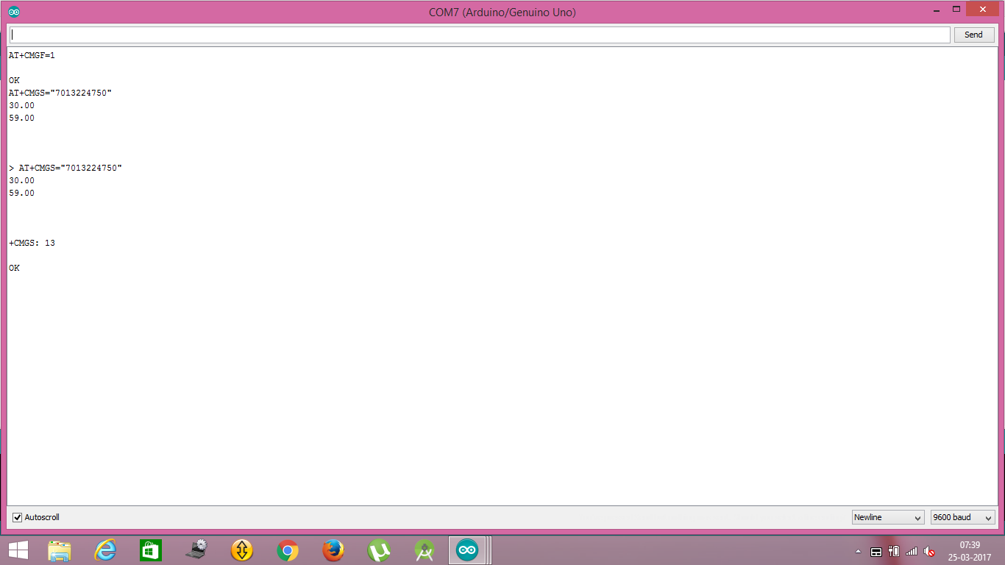
Screen shot of sending message:

Slide 26
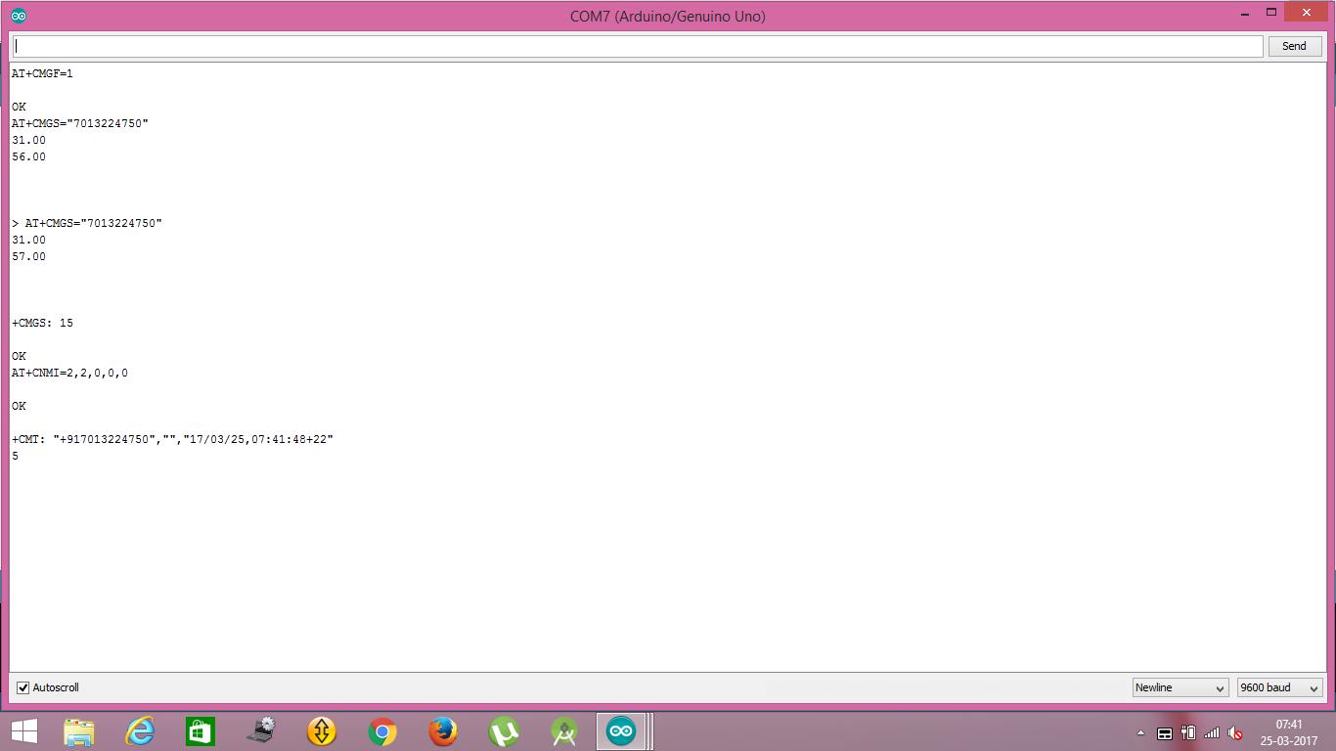
Screen shot of receiving message:

Slide 27
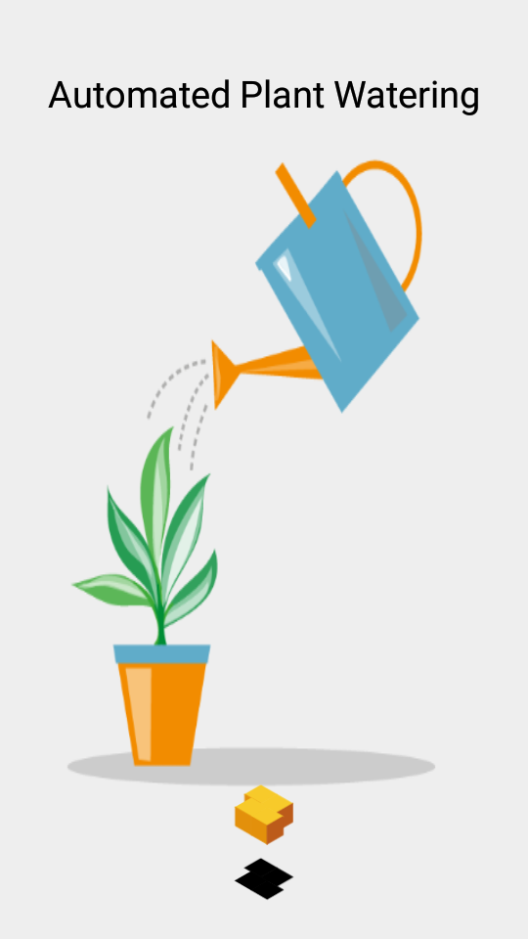
Screen shot of splash screen:

Slide 28
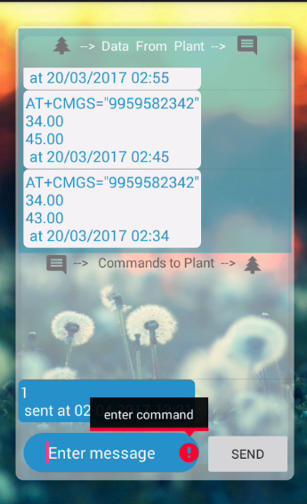
Screen shot of message display screen with error:

Slide 29
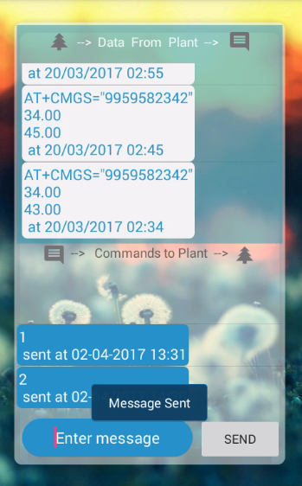
Screen shot of toast message:

Slide 30
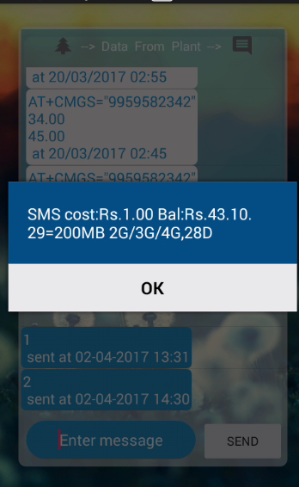
Screen shot of sending message through mobile app:

Slide 31
Conclusion:
This is a simple watering system, which is very easy to use. The user can water the plant by just instructing the system through a simple text message from anywhere out of the home. So, this is a system which eases the gardener’s task of watering a plant and ensures the healthy growth of the plant.

Slide 32
Future scope:
Future scope of this project is to extend the functionalities like automatically shifting the control to the system without involving the human completely. The plant will be watered according to the conditions specified by the programmer previously.

Slide 33
References:
https://developer.android.com/index.html
https://github.com/android
http://stackoverflow.com/documentation/android/topics
http://www.instructables.com
http://www.arduino.cc

Slide 34
QUERIES?

Slide 35
Thank you….!

